Slide 1
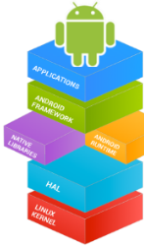



Mobile Application Development (COS7025-B) Designing Mobile Apps using Android Text View, Scrolling View, Recycler View and Intents
Karim Hammoud Sadik
Lecture #4
Android Studio

Slide 2
Contents
Defining Text View
Defining Scrolling View
Defining Recycler View
Starting a new Activity with an Intent
Passing data between activities with extras
Navigating between activities

Slide 3
TextView for text
TextView is View subclass for single and multi-line text
EditText is TextView subclass with editable text
Controlled with layout attributes
Set text:
Statically from string resource in XML
Dynamically from Java code and any source

Slide 4
Formatting text in string resource
Use <b> and <i> HTML tags for bold and italics
All other HTML tags are ignored
String resources: one unbroken line = one paragraph
\n starts a new a line or paragraph
Escape apostrophes and quotes with backslash (\", \')
Escape any non-ASCII characters with backslash (\)

Slide 5
Creating TextView in XML
<TextView android:id="@+id/textview"
android:layout_width="match_parent"
android:layout_height="wrap_content"
android:text="@string/my_story"/>

Slide 6
Common TextView attributes
android:text—text to display
android:textColor—color of text
android:textAppearance—predefined style or theme
android:textSize—text size in sp
android:textStyle—normal, bold, italic, or bold|italic
android:typeface—normal, sans, serif, or monospace
android:lineSpacingExtra—extra space between lines in sp

Slide 7
Formatting active web links
<string name="article_text">... www.rockument.com ...</string>
<TextView
android:id="@+id/article"
android:layout_width="wrap_content"
android:layout_height="wrap_content"
android:autoLink="web"
android:text="@string/article_text"/>
Don’t use HTML for a web link in free-form text
autoLink values:"web", "email", "phone", "map", "all"

Slide 8
Creating TextView in Java code
TextView myTextview = new TextView(this);
myTextView.setWidth(LayoutParams.MATCH_PARENT);
myTextView.setHeight(LayoutParams.WRAP_CONTENT);
myTextView.setMinLines(3);
myTextView.setText(R.string.my_story);
myTextView.append(userComment);

Slide 9
What about large amounts of text?
News stories, articles, etc…
To scroll a TextView, embed it in a ScrollView
Only one View element (usually TextView) allowed in a ScrollView
To scroll multiple elements, use one ViewGroup (such as LinearLayout) within the ScrollView

Slide 10
ScrollView for scrolling content
ScrollView is a subclass of FrameLayout
Holds all content in memory
Not good for long texts, complex layouts
Do not nest multiple scrolling views
Use HorizontalScrollView for horizontal scrolling
Use a RecyclerView for lists

Slide 11
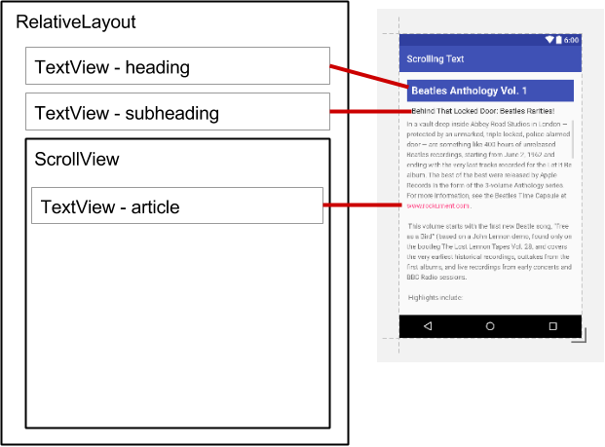
ScrollView layout with one TextView
<ScrollView
android:layout_width="wrap_content"
android:layout_height="wrap_content"
android:layout_below="@id/article_subheading">
<TextView
android:layout_width="wrap_content"
android:layout_height="wrap_content"
.../>
</ScrollView>

Slide 12
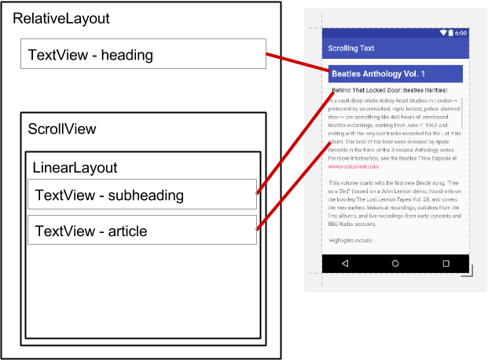
ScrollView layout with a view group
<ScrollView ...
<LinearLayout
android:layout_width="match_parent"
android:layout_height="wrap_content"
android:orientation="vertical">
<TextView
android:id="@+id/article_subheading" .../>
<TextView
android:id="@+id/article" ... />
</LinearLayout>
</ScrollView>

Slide 13
ScrollView with image and button
<ScrollView...> <LinearLayout...> <ImageView.../> <Button.../> <TextView.../> </LinearLayout> </ScrollView>
One child of ScrollView which can be a layout
Children of the layout

Slide 14
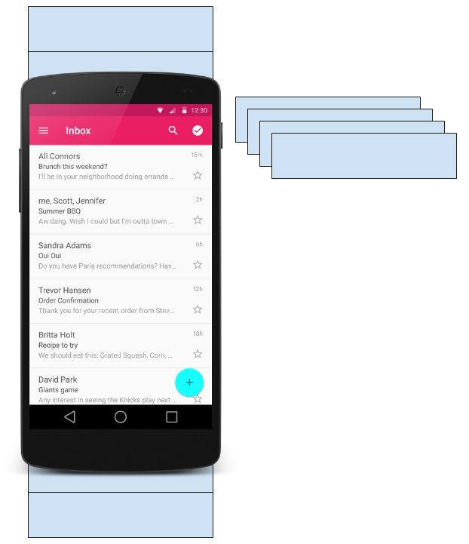
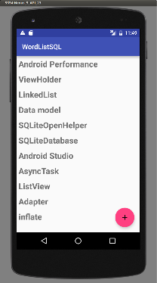
What is a RecyclerView?
RecyclerView is scrollable container for large data sets
Efficient
Uses and reuses limited number of View elements
Updates changing data fast

Slide 15
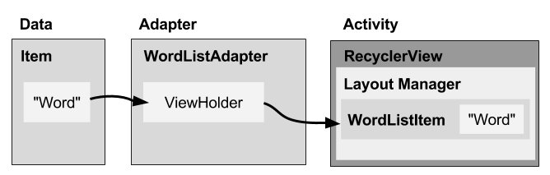
Overview
Data
RecyclerView scrolling list for list items—RecyclerView
Layout for one item of data—XML file
Adapter connects data to the RecyclerView—RecyclerView.Adapter
Layout manager handles the organization of UI components in a View—Recyclerview.LayoutManager
ViewHolder has view information for displaying one item—RecyclerView.ViewHolder

Slide 16
What is a layout manager?
Each ViewGroup has a layout manager
Use to position View items inside a RecyclerView
Reuses View items that are no longer visible to the user
Built-in layout managers
LinearLayoutManager
GridLayoutManager
StaggeredGridLayoutManager
Extend RecyclerView.LayoutManager

Slide 17
What is an adapter?
Helps incompatible interfaces work together
Example: Takes data from database Cursor and prepares strings to put into a View
Intermediary between data and View
Manages creating, updating, adding, deleting View items as underlying data changes
RecyclerView.Adapter

Slide 18
What is a ViewHolder?
Used by the adapter to prepare one View with data for one list item
Layout specified in an XML resource file
Can have clickable elements
Is placed by the layout manager
RecyclerView.ViewHolder

Slide 19
Implementing RecyclerView
Add RecyclerView dependency to build.gradle if needed
Add RecyclerView to layout
Create XML layout for item
Extend RecyclerView.Adapter
Extend RecyclerView.ViewHolder
In Activity onCreate(), create RecyclerView with adapter and layout manager

Slide 20
Create the view holder in adapter class
class WordViewHolder extends RecyclerView.ViewHolder { //.. }
If you want to handle mouse clicks:
class WordViewHolder extends RecyclerView.ViewHolder
implements View.OnClickListener { //.. }

Slide 21
View holder constructor
public WordViewHolder(View itemView, WordListAdapter adapter) {
super(itemView);
// Get the layout
wordItemView = itemView.findViewById(R.id.word);
// Associate with this adapter
this.mAdapter = adapter;
// Add click listener, if desired
itemView.setOnClickListener(this);
}
// Implement onClick() if desired

Slide 22
Learn more
RecyclerView
RecyclerView class
RecyclerView.Adapter class
RecyclerView.ViewHolder class
RecyclerView.LayoutManager class

Slide 23
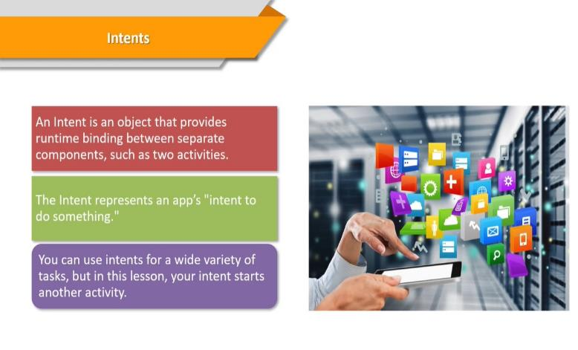
Intents
What is an intent?

Slide 24
What can intents do?
Start an Activity
A button click starts a new Activity for text entry
Clicking Share opens an app that allows you to post a photo
Start an Service
Initiate downloading a file in the background
Deliver Broadcast
The system informs everybody that the phone is now charging

Slide 25
Explicit and implicit intents
Explicit Intent
Starts a specific Activity
Request tea with milk delivered by someone
Main activity starts the ViewShoppingCart Activity
Implicit Intent
Asks system to find an Activity that can handle this request
Find an open store that sells green tea
Clicking Share opens a chooser with a list of apps

Slide 26
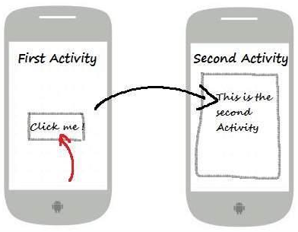
Start an Activity with an explicit intent
To start a specific Activity, use an explicit Intent
Create an Intent
Intent intent = new Intent(FirstActivity.this, SecondActivity.class);
Use the Intent to start the Activity
startActivity(intent);

Slide 27
Start an Activity with implicit intent
To ask Android to find an Activity to handle your request, use an implicit Intent
Create an Intent
Intent intent = new Intent(action, uri);
Use the Intent to start the Activity
startActivity(intent);

Slide 28
Implicit Intents - Examples
Show a web page Uri uri = Uri.parse("http://www.google.com"); Intent it = new Intent(Intent.ACTION_VIEW,uri); startActivity(it);
Dial a phone number Uri uri = Uri.parse("tel:8005551234");
Intent it = new Intent(Intent.ACTION_DIAL, uri);
startActivity(it);

Slide 29
Sending and retrieving data with Intents
In the first (sending) Activity:
Create the Intent object
Put data or extras into that Intent
Start the new Activity with startActivity()
In the second (receiving) Activity:
Get the Intent object, the Activity was started with
Retrieve the data or extras from the Intent object

Slide 30
Putting a URI as intent data
// A web page URL
intent.setData(
Uri.parse("http://www.google.com"));
// a Sample file URI
intent.setData(
Uri.fromFile(new File("/sdcard/sample.jpg")));

Slide 31
Put information into intent extras
putExtra(String name, int value) ⇒ intent.putExtra("level", 406);
putExtra(String name, String[] value) ⇒ String[] foodList = {"Rice", "Beans", "Fruit"}; intent.putExtra("food", foodList);
putExtras(bundle); ⇒ if lots of data, first create a bundle and pass the bundle.
See documentation for all

Slide 32
Sending data to an activity with extras
public static final String EXTRA_MESSAGE_KEY = "com.example.android.twoactivities.extra.MESSAGE";
Intent intent = new Intent(this, SecondActivity.class);
String message = "Hello Activity!";
intent.putExtra(EXTRA_MESSAGE_KEY, message);
startActivity(intent);

Slide 33
Get data from intents
getData(); ⇒ Uri locationUri = intent.getData();
int getIntExtra (String name, int defaultValue) ⇒ int level = intent.getIntExtra("level", 0);
Bundle bundle = intent.getExtras(); ⇒ Get all the data at once as a bundle.

Slide 34
Returning data to the starting activity
Use startActivityForResult() to start the second Activity
To return data from the second Activity:
Create a new Intent
Put the response data in the Intent using putExtra()
Set the result to Activity.RESULT_OK or RESULT_CANCELED, if the user cancelled out
call finish() to close the Activity
Implement onActivityResult() in first Activity

Slide 35
startActivityForResult()
startActivityForResult(intent, requestCode);
Starts Activity (intent), assigns it identifier (requestCode)
Returns data via Intent extras
When done, pop stack, return to previous Activity, and execute onActivityResult() callback to process returned data
Use requestCode to identify which Activity has "returned"

Slide 36
startActivityForResult() Example
public static final int CHOOSE_FOOD_REQUEST = 1;
Intent intent = new Intent(this, ChooseFoodItemsActivity.class);
startActivityForResult(intent, CHOOSE_FOOD_REQUEST);

Slide 37
Return data and finish second activity
// Create an intent
Intent replyIntent = new Intent();
// Put the data to return into the extra
replyIntent.putExtra(EXTRA_REPLY, reply);
// Set the activity's result to RESULT_OK
setResult(RESULT_OK, replyIntent);
// Finish the current activity
finish();

Slide 38
Implement onActivityResult()
public void onActivityResult(int requestCode,
int resultCode, Intent data) {
super.onActivityResult(requestCode, resultCode, data);
if (requestCode == TEXT_REQUEST) { // Identify activity
if (resultCode == RESULT_OK) { // Activity succeeded
String reply = data.getStringExtra(SecondActivity.EXTRA_REPLY);
// … do something with the data
}}}

Slide 39
Any Questions?

